Slide 1
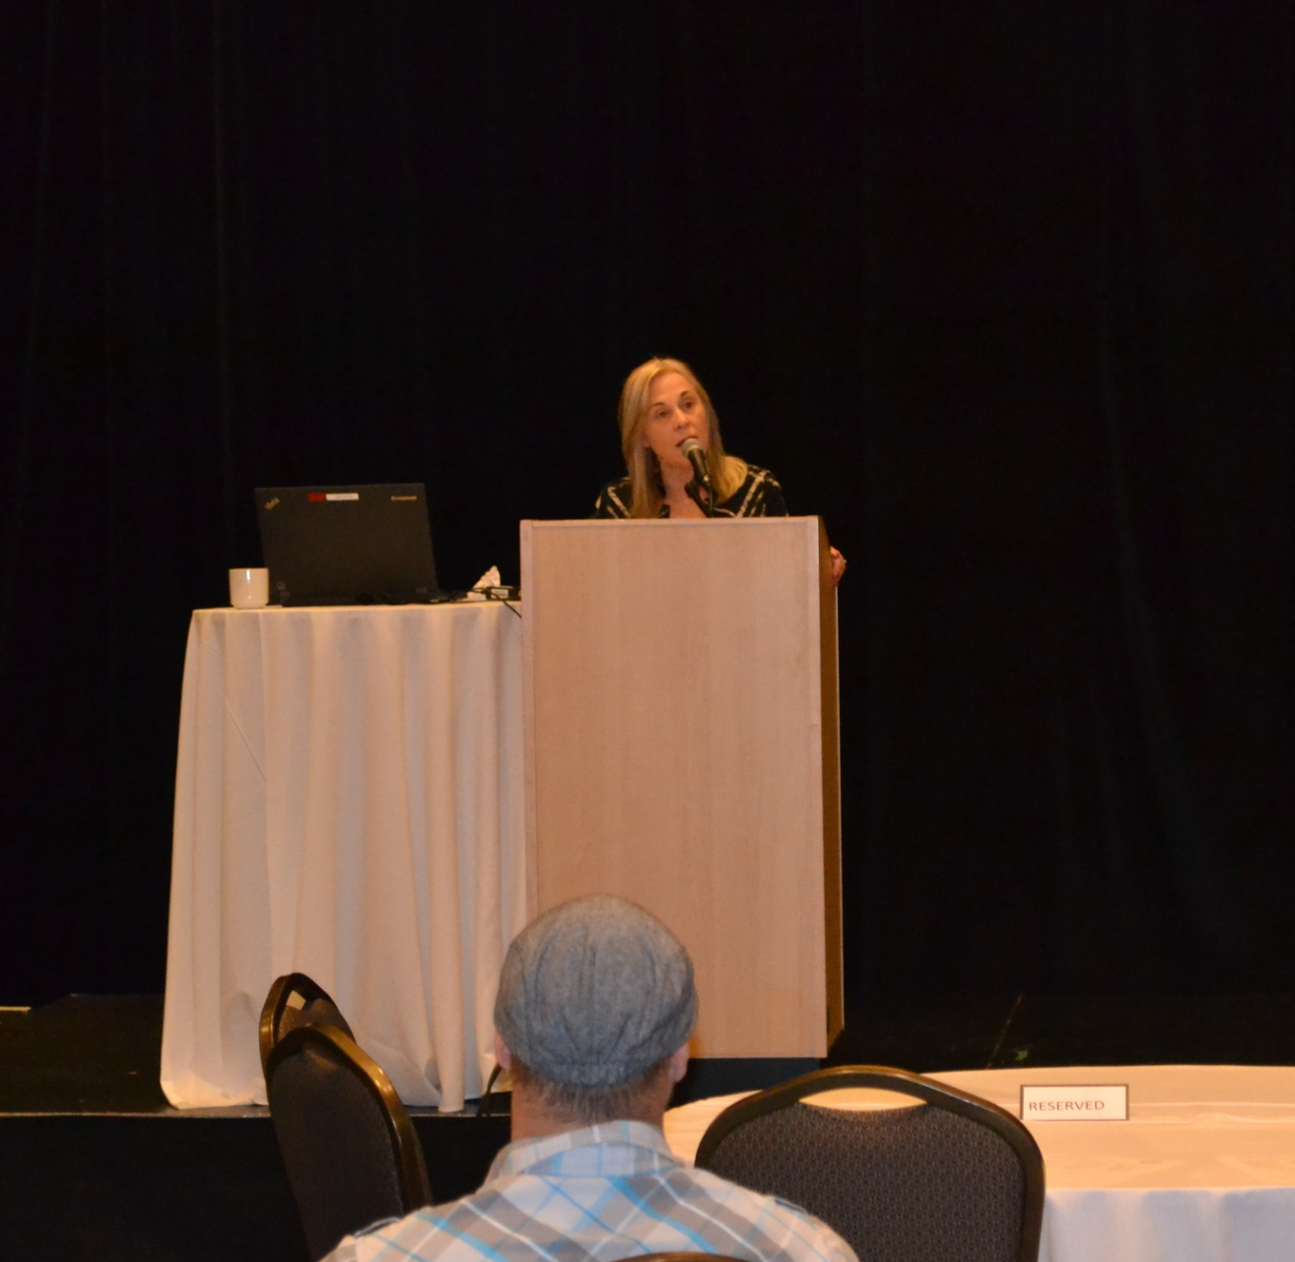
2017 OADD Annual Conference Awards Ceremony
Opening Greeting from Minister Helene Jaczek (provided by ADM Karen Chan)

Slide 2
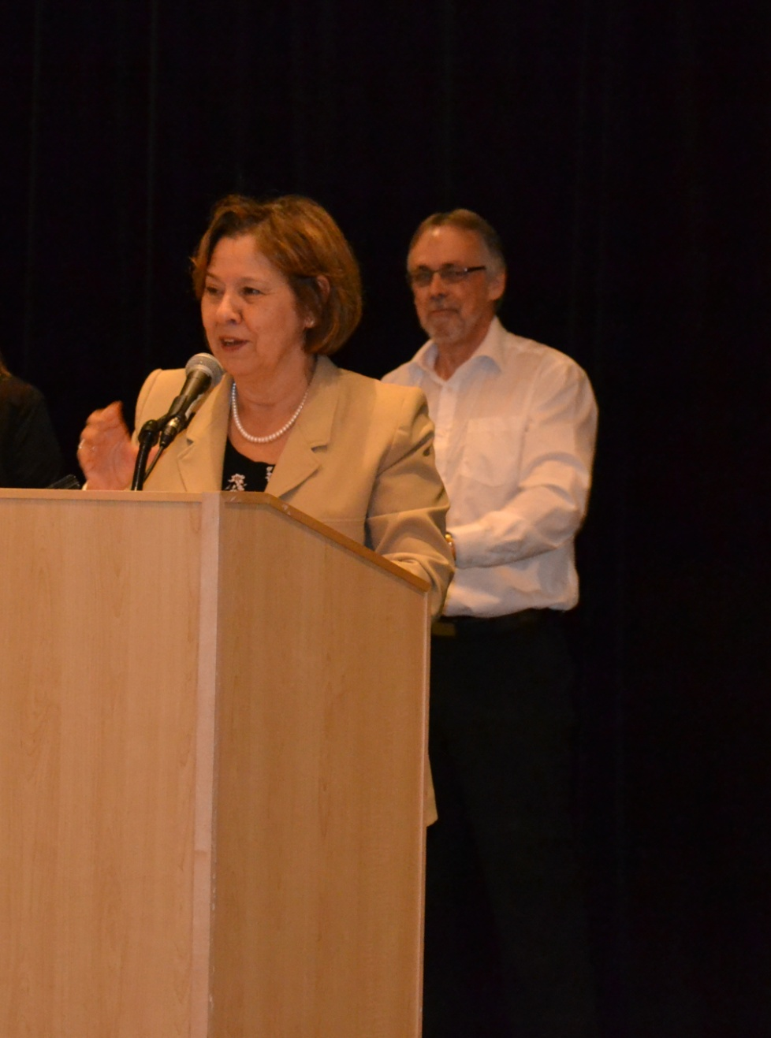
2017 OADD Annual Conference Awards Ceremony
Hull Roeher Award of Excellence awarded to Dr. Robert Hickey (accepted by Nancy Wallace-Gero)

Slide 3
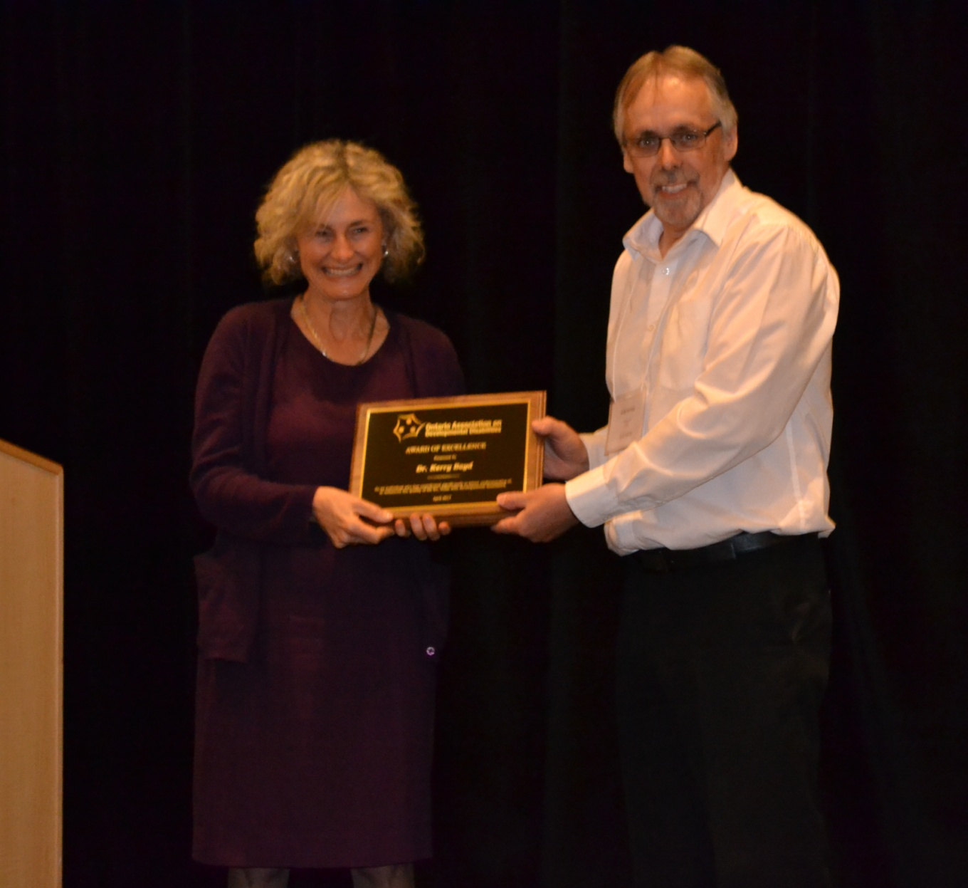
2017 OADD Annual Conference Awards Ceremony
Dr. Kerry Boyd accepting the OADD Award of Excellence
(presented by former OADD Board Chair Wade Durling)

Slide 4
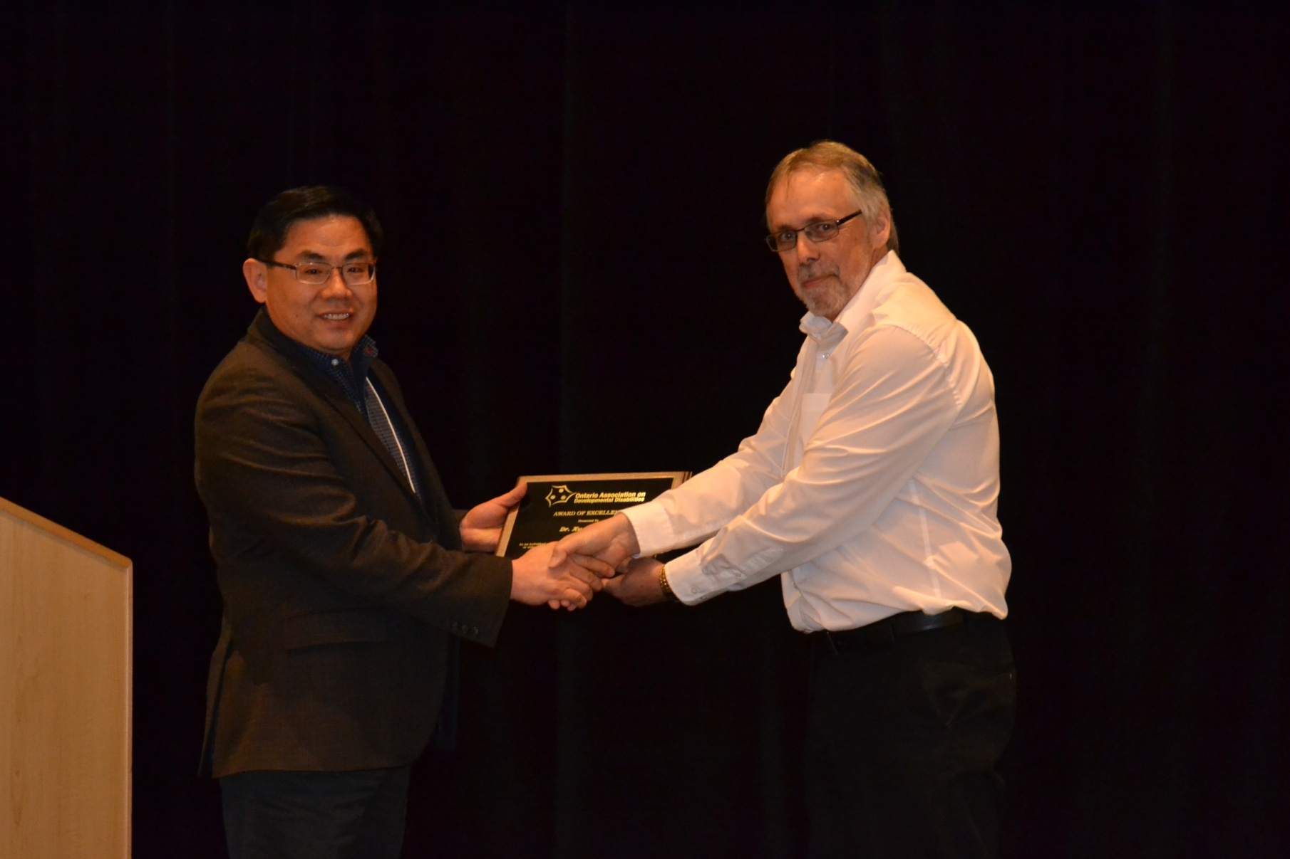
2017 OADD Annual Conference Awards Ceremony
Dr. Xudong Liu accepting the OADD Award of Excellence
(presented by former OADD Board Chair Wade Durling)

Slide 5
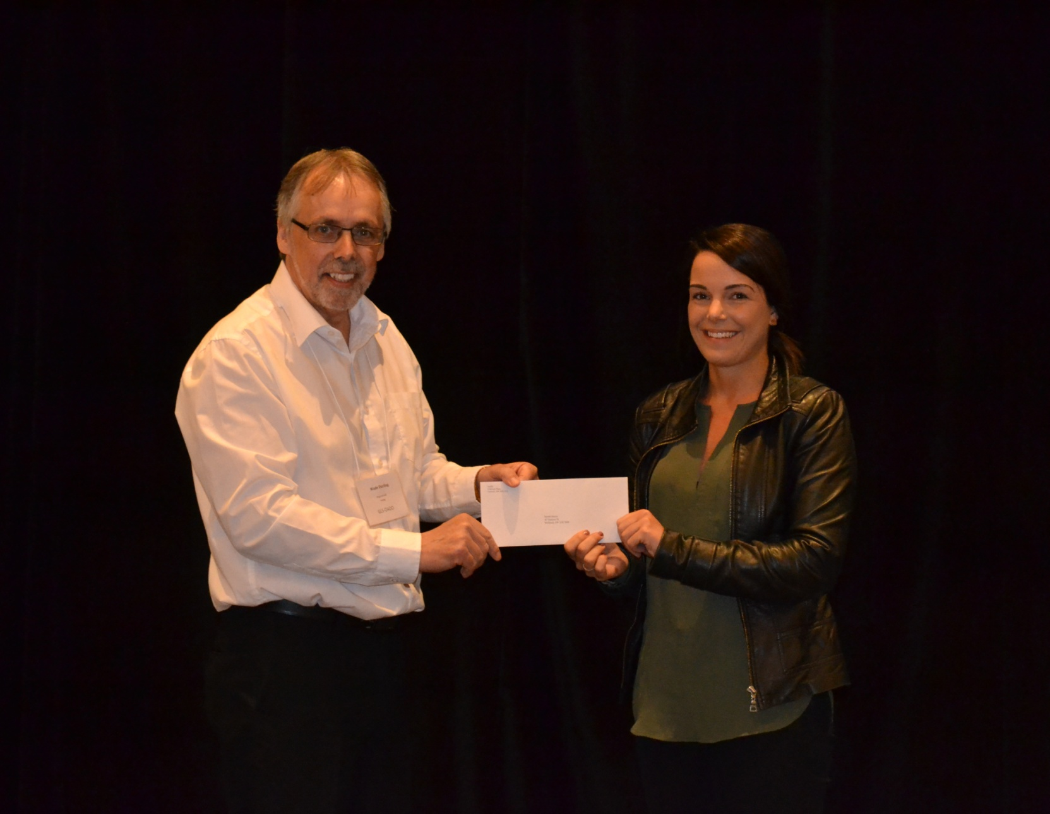
2017 OADD Annual Conference Awards Ceremony
Sarah Davis – recipient of the 2017 Kay Sansom Scholarship, Graduate Level
(one of three $1,000 Scholarships for student in the field of Developmental Disabilities)

Slide 6
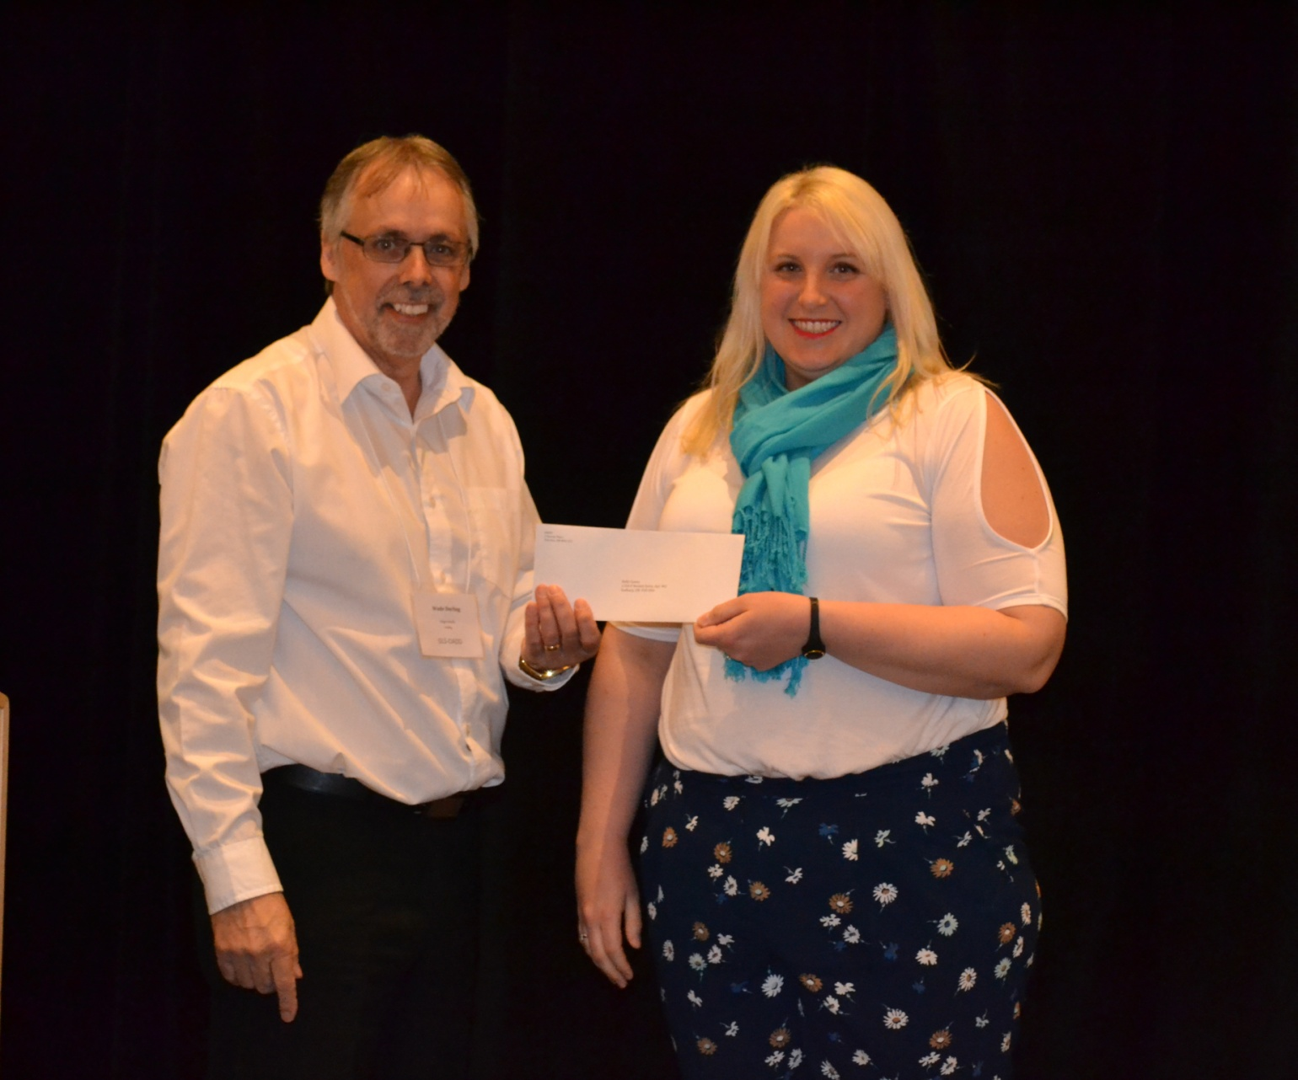
2017 OADD Annual Conference Awards Ceremony
Kelly Coons – recipient of the 2017 OADD-NADD Ontario Participation Scholarship
(one of three New NADD Ontario funded Scholarships)

